Slide 1
Two sides of the same coin? An ethnographic exploration of primary care staff and link worker perspectives on social prescribing
Dr Bethan Griffith, Professor Suzanne Moffatt & Professor Tessa Pollard

Slide 2
Social Prescribing
Client
LW
VCSE
GP

Slide 3
Client
LW
VCSE
GP

Slide 4
Client
LW
VCSE
GP

Slide 5
Client
LW
VCSE
GP

Slide 6
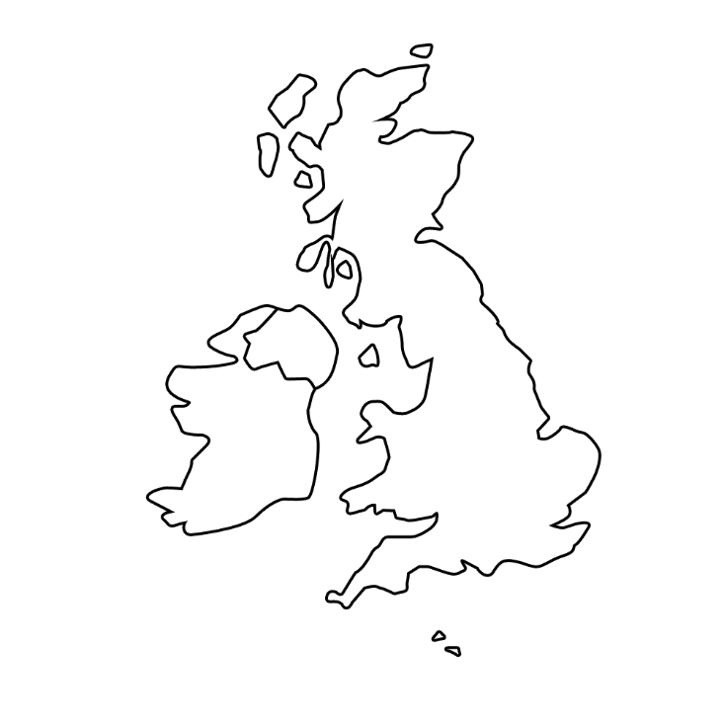
Ethnography
Client
LW
VCSE
GP

Slide 7
Ethnography
Client
LW
VCSE
GP

Slide 8
Client
LW
VCSE
GP
Referral Criteria: 40-74yo; Long Term Conditions
Funding: Social Impact Bond

Slide 9
Client
LW
VCSE
GP

Slide 10
Client
LW
VCSE
I’ll think about it
GP

Slide 11
Client
LW
VCSE
Who's eligible?... Who’s the link worker?
GP

Slide 12
Client
LW
VCSE
GP

Slide 13
Client
LW
VCSE
Targets….caseload….outputs…I thought there’d be more supporting
GP

Slide 14
Client
LW
VCSE
GP

Slide 15
Client
LW
VCSE
GP

Slide 16
Client
LW
VCSE
Where’s the money going to come from?
GP

Slide 17
?
Client
LW
VCSE
GP

Slide 18
Client need
Link worker subjectivities
Funding arrangements
High staff turnover
Outputs, targets & caseloads
Differentiated referral practices
Good primary care engagement

Slide 19
Client need
Link worker subjectivities
Funding arrangements
High staff turnover
Outputs, targets & caseloads
Differentiated referral practices
Good primary care engagement

Slide 20
Thanks & Acknowledgments
Link Worker Ethnography:
Conducted as part of a wider study funded by the National Institute for Health Research (NIHR) Public Health Research Programme, Community Groups and Health Promotion (project reference 16/122/33). The views expressed are those of the author(s) and not necessarily those of the NIHR or the Department of Health and Social Care.
With thanks to Professor Suzanne Moffatt, Professor Tessa Pollard, Dr Jayne Jeffries, Dr Kate Gibson & Dr Stephanie Morris
Primary Care Ethnography:
Conducted as part of the presenters PhD, funded by the ESRC (Economic & Social Research Council) Northern Ireland and North East Doctoral Training Programme: Health, Wellbeing & Society pathway.
With thanks to Professor Suzanne Moffatt and Professor Cathrine Degnen
Contact: Dr Bethan Griffith (b.s.griffith2@ncl.ac.uk)

